Slide 1
Optimization with Shubert-Piyavskii Method
Finding Global Minima of Continuous Functions
Ali Janloo
Ali Alavizadeh
Amir Ali Akhgari

Slide 2
Introduction to Shubert-Piyavskii Method
The Shubert-Piyavskii method is a global optimization technique used to find the global minimum of a function within a given interval. Unlike some other optimization methods, it can converge to the global minimum regardless of the presence of local minima or the function's shape. The method relies on the function being Lipschitz continuous, meaning it must be continuous and have an upper bound on the magnitude of its derivative.

Slide 3
Lipschitz Continuity
A function f is Lipschitz continuous on the interval [a, b] if there exists a Lipschitz constant L > 0 such that:
|f(x) - f(y)| ≤ L|x-y|
or all x, y in [a, b]. Intuitively, L represents the largest unsigned instantaneous rate of change the function attains on the interval.

Slide 4
Algorithm Overview (Initialization)
The method starts by sampling the midpoint of the interval.
It constructs a sawtooth lower bound using lines of slope ± L from this midpoint. These lines always lie below the function if L is a valid Lipschitz constant.

Slide 5
Algorithm Overview (Iteration)
The algorithm iteratively builds a tighter lower bound on the function.
It stops when the difference in height between the minimum sawtooth value and the function evaluation at that point is less than a given tolerance epsilon.

Slide 6
Uncertainty Regions
Regions where the minimum could lie are computed based on the update information.
An uncertainty region is computed for every peak, with contributions determined by the sawtooth lower vertices and the minimum sawtooth upper vertex.

Slide 7
Advantages
Converges to the global minimum irrespective of local minima or function shape.
Handles complex function landscapes effectively.
Robust against local minima.

Slide 8
Considerations
Requires a valid Lipschitz constant, which may be a drawback.
Poor performance may result from large Lipschitz constants.

Slide 9
Applications
Engineering optimization.
Financial modeling.
Machine learning parameter tuning.
Scientific research.

Slide 10
Conclusion
The Shubert-Piyavskii method offers a powerful approach to global optimization, guaranteeing convergence to the global minimum under certain conditions. By iteratively refining a lower bound on the function, it effectively navigates complex function landscapes and identifies potential regions for the minimum. While requiring knowledge of a valid Lipschitz constant, its robustness and ability to handle various function shapes make it a valuable tool in optimization problems.

Slide 11
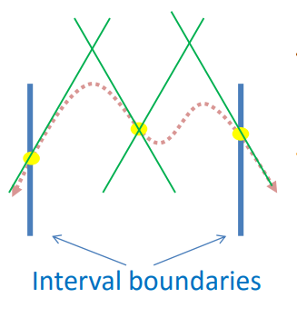
Example
Consider Function:
y = -x^4 + 4x^33 + 30x^2 – 50x + 200
and boundaries -5 and 7, and a maximum slope of 450

Slide 12
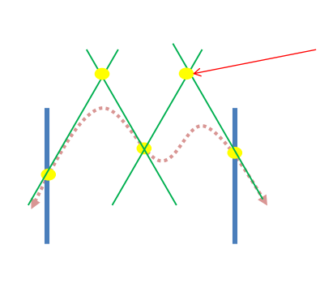
Once you have found where the lines cross, you have five points:

Slide 13
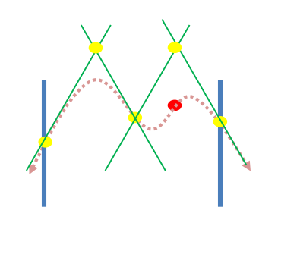
Take the x-value of the highest point and plug that into the function to find the actual y-value of the function at that location.

Slide 14
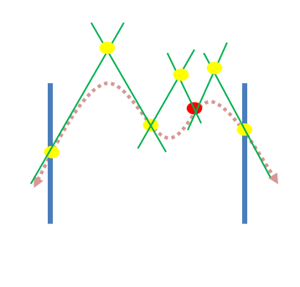
Create new lines from the new point. Then find the new crossing points.

Slide 15
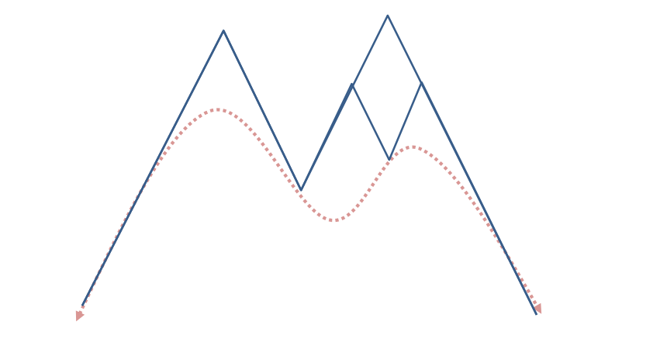

Slide 16
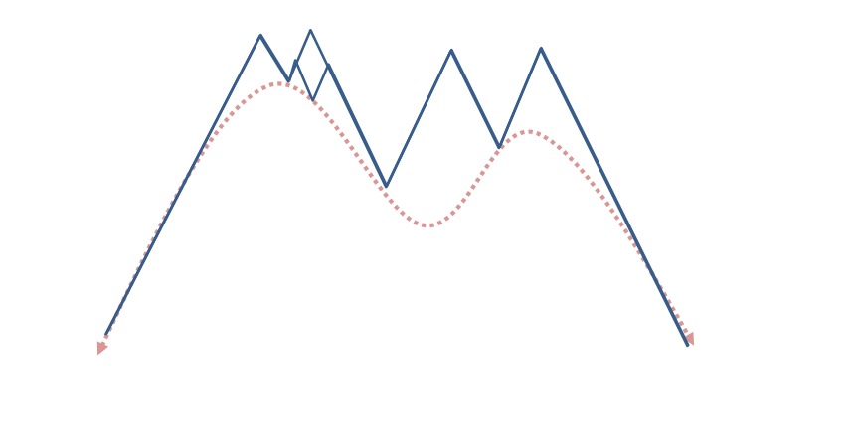

Slide 17
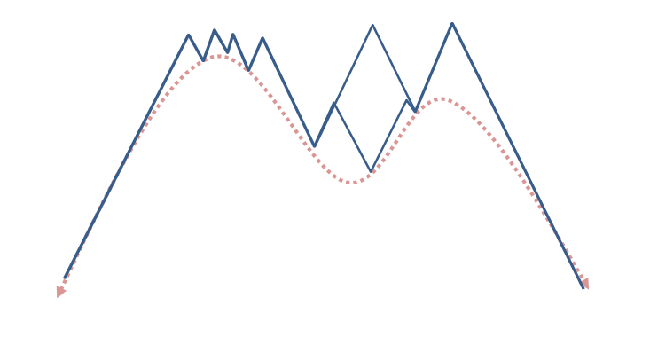

Slide 18
